Slide 1
Re-run Last Executed Commands in Linux alias command in Linux Linux - Shell Functions

Slide 2
Re-run Last Executed Commands in Linux
It would be quite efficient to re-execute the last command. If the command was quite big to type in again, this would be quite a great trick to improve efficiency. So let us see what the commands are to run the last executed command again in the Linux terminal. The ways to run the last executed command are as follows:
Ctrl + P
Up Arrow key.
bang-bang operator.
N^{th} bang operator.
fc command.

Slide 3
1) Ctrl + P
This is the most dependable shortcut in Linux to execute the last run command in the terminal. Just press the Ctrl and P keys together to fill the prompt with the last executed command and you are ready to go. This method works in bash perfectly even after closing the terminal, but it might not work in zsh after closing the session. But still, it is quite more reliable than other methods.

Slide 4
2) Up Arrow key
Simply works most of the time, using arrow keys is the most popular way to search through previous commands. This is the most known and used a keyboard shortcut to run the previous commands. The usage It’s quite straightforward to use the up arrow key to search through the previously executed command.

Slide 5
3) Using a double bang(!) operator
Double bang or !! is also one of the ways where you can run the last command. It is also known as the bang-bang command, which repeats the previously executed command as previously mentioned.
!!

Slide 6
4) Single bang (!) search
The single band operator is followed by the number, which tells it which previous command it would run. For running the last command, we use !-1, indicating the last command, if we use !-2, we will run the second-last command and so forth. The bang operator searches for commands from the shell history and executes as the mentioned number accordingly.
!-1

Slide 7
5) Using fc command
FC is a program built-in certain popular shells to work with the previously executed commands. We can use it for executing the last command very easily by just entering a flag or argument into it.
fc -sBy adding in -s, we can easily execute the last run command.

Slide 8
alias command in Linux
alias command instructs the shell to replace one string with another string while executing the commands.
When we often have to use a single big command multiple times, in those cases, we create something called as alias for that command. Alias is like a shortcut command which will have same functionality as if we are writing the whole command.
Syntax:
alias [-p] [name[=value] ... ]
Creating an alias :
Syntax:
alias name="value"

Slide 9
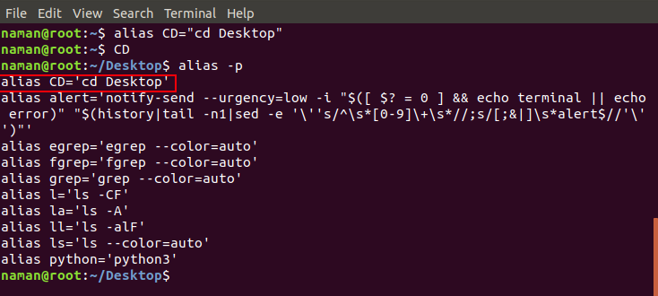

Slide 10
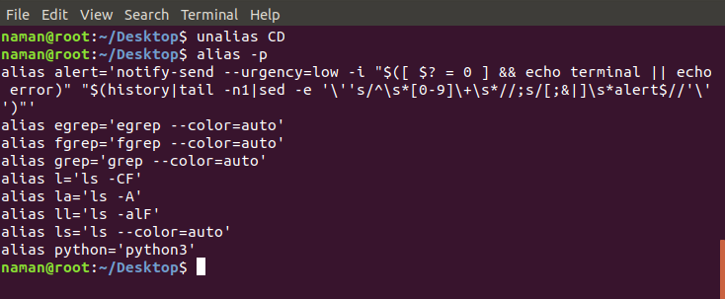
Creating an Unalias
Creating an Unalias : Removing an existing alias is known as unaliasing. Syntax:
unalias [alias name]

Slide 11
Linux - Shell Functions
Functions enable you to break down the overall functionality of a script into smaller, logical subsections, which can then be called upon to perform their individual tasks when needed.
Using functions to perform repetitive tasks is an excellent way to create code reuse. This is an important part of modern object-oriented programming principles.
Shell functions are similar to subroutines, procedures, and functions in other programming languages.

Slide 12
Creating Functions
To declare a function, simply use the following syntax −
function_name () { list of commands} The name of your function is function_name, and that's what you will use to call it from elsewhere in your scripts. The function name must be followed by parentheses, followed by a list of commands enclosed within braces.

Slide 13
Example
#!/bin/sh
# Define your function here
Hello () {
echo "Hello World"
}
# Invoke your function
Hello

Slide 14
Pass Parameters to a Function
You can define a function that will accept parameters while calling the function. These parameters would be represented by $1, $2 and so on.
Following is an example where we pass two parameters Zara and Ali and then we capture and print these parameters in the function.

Slide 15
#!/bin/sh
# Define your function here
Hello () {
echo "Hello World $1 $2"
}
# Invoke your function
Hello Zara Ali

Slide 16
Returning Values from Functions
If you execute an exit command from inside a function, its effect is not only to terminate execution of the function but also of the shell program that called the function.
If you instead want to just terminate execution of the function, then there is way to come out of a defined function.
Based on the situation you can return any value from your function using the return command whose syntax is as follows −
return code Here code can be anything you choose here, but obviously you should choose something that is meaningful or useful in the context of your script as a whole.

Slide 17
#!/bin/sh
# Define your function here
Hello () {
echo "Hello World $1 $2"
return 10
}
# Invoke your function
Hello Zara Ali
# Capture value returnd by last command
ret=$?
echo "Return value is $ret"

Slide 18
Nested Functions
One of the more interesting features of functions is that they can call themselves and also other functions. A function that calls itself is known as a recursive function.
Following example demonstrates nesting of two functions −

Slide 19
#!/bin/sh
# Calling one function from another
number_one () {
echo "This is the first function speaking..."
number_two
}
number_two () {
echo "This is now the second function speaking..."
}
# Calling function one.
number_one

Slide 20
Function Call from Prompt
You can put definitions for commonly used functions inside your .profile. These definitions will be available whenever you log in and you can use them at the command prompt.
Alternatively, you can group the definitions in a file, say test.sh, and then execute the file in the current shell by typing −
$. test.sh
This has the effect of causing functions defined inside test.sh to be read and defined to the current shell as follows −

Slide 21
$ number_one
This is the first function speaking...This is now the second function speaking...$ To remove the definition of a function from the shell, use the unset command with the .f option. This command is also used to remove the definition of a variable to the shell.
$ unset -f function_name

